Slide 1
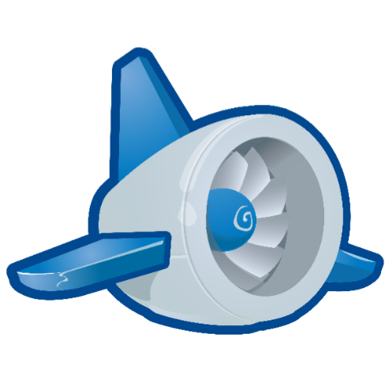
Google App Engine Tutorial
Joe Gregorio
Developer Advocate
Google App Engine
Joe Gregorio
Developer Advocate
Google App Engine

Slide 2
Registering
Registering and Creating an App Id

Slide 3
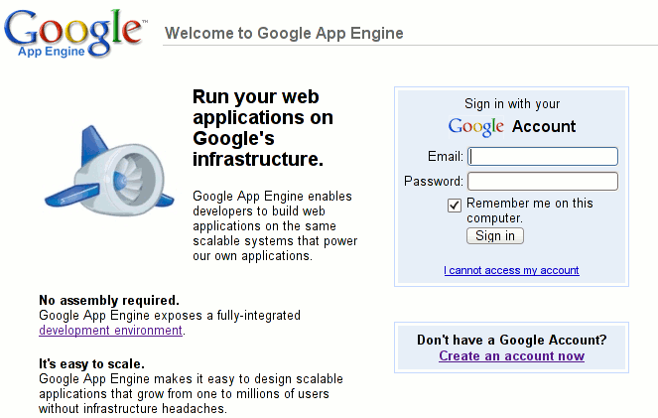
Registering
http://appspot.com

Slide 4
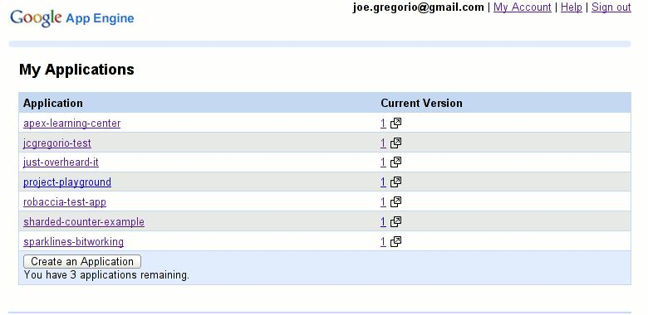
Create an App Id

Slide 5

Modify 'app.yaml'
application: new-project-template
version: 1
runtime: python
api_version: 1
handlers:
- url: .*
script: main.py

Slide 6
Upload the default application
$ cd google_appengine/new_project_template/
~/Desktop/google_appengine/new_project_template
$ python ../appcfg.py update .
Scanning files on local disk.
Initiating update.
Email: ...

Slide 7
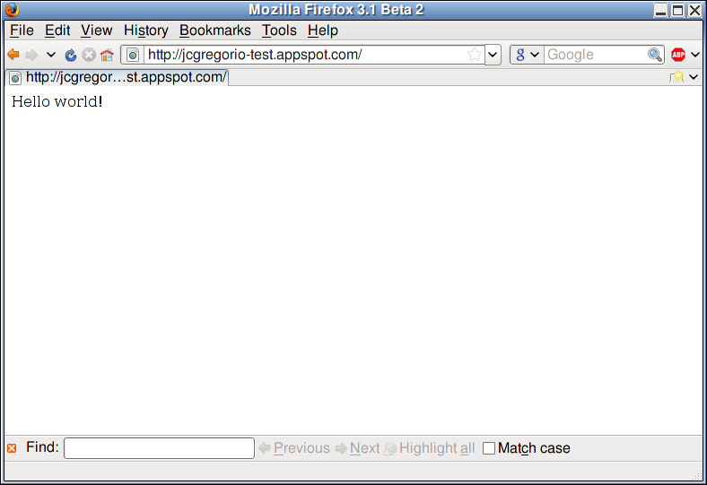
Check it out`

Slide 8
Thank You
Questions?

